Slide 1

Selected Topics in Python Using Pandas
Notes:
‹#›

Slide 2

Objectives
Objectives
What is Pandas?
Slicing data frame.
Concatenation.
Change index.
Change headers.
Merging and joining.
Notes:
‹#›

Slide 3

What is Pandas?
Preform data operations
Series.
Data frames.
Missing data.
Group data.
Notes:
Series are very similar to one-dimensional Numpy arrays.
Data parameter in this definition could be:
A constant value
A list
A Numpy array
A dictionary
We can think of DataFrame as a table with different types of columns and rows, so that we can process the data more easily. We can define a DataFrame as a code script.
Missing Data
We can use pandas to help us identify area where we are missing data from a column or row.
Finally, we can use data sets from different areas like Economic Research
Recommendation and Analysis of Systems
Stock Prediction
Advertising
Big Data
‹#›

Slide 4
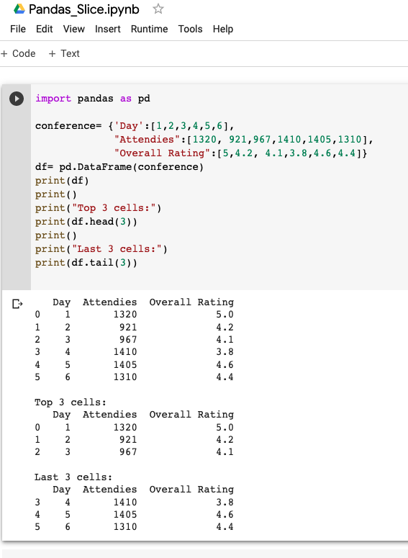
Slicing Data Frame
Slice
Show all.
Show number of rows from head.
Show number of rows from tail.
Notes:
‹#›

Slide 5
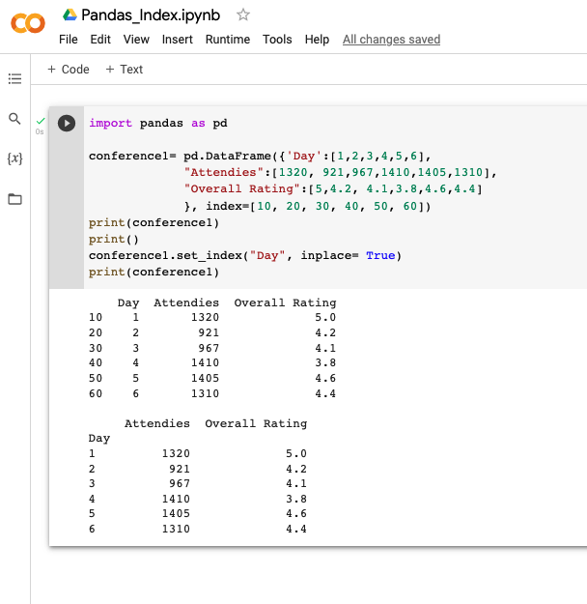
Change Index
Set index

Slide 6
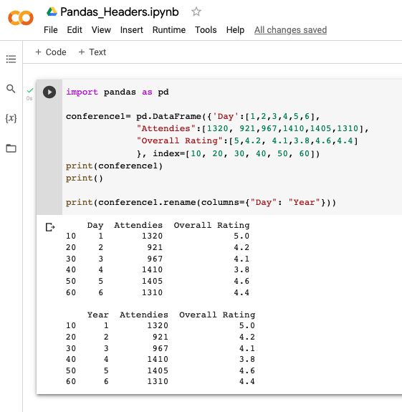
Change Headers
Modify header name
Notes:
‹#›

Slide 7
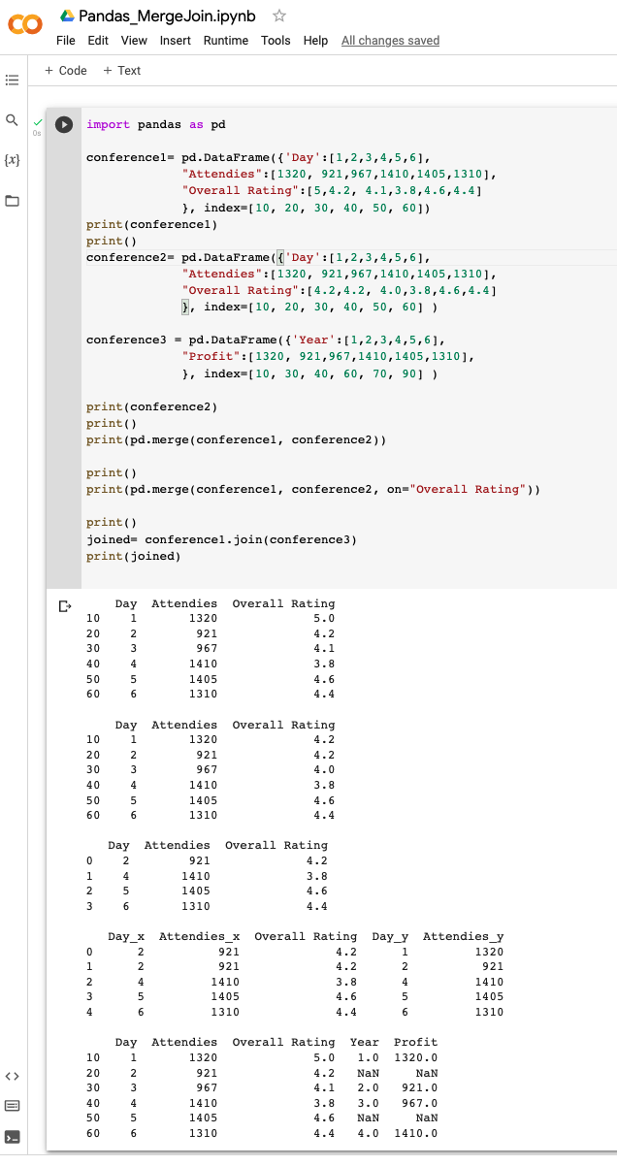
Merging and Joining
Merge and join data
Notes:
These are just some of the basic functions that are built into the Pandas library. Take some time and try some of the other things that you can do with Pandas. See you in the next video.
‹#›

